Slide 1
Arrays

Slide 2
Introduction to Arrays
Arrays can hold sets of data of the same type.
An array has a name and the values stored in it can be accessed by an index.
The indexing of arrays starts at zero and you cannot change this behaviour.
Declaring Arrays
Arrays must be declared with the Dim (or Public, or Private) statement followed by the name of the array and the index of the last element in the array in parentheses
Example:
Dim salaries(15) As Integer
To assign values to the elements:
salaries(0) = 30000

Slide 3
Array Limits
The first element of the array has index 0.
The number that appears in parentheses in the Dim statement is one less than the array’s total capacity and is array’s upper limit (or upper bound).
Example: Dim a(19) As Integer
In this case the upper bound of the array is 19 and its capacity is 20 elements.
Initializing Arrays
You can initialize an array in the same line where you declare the array, as
Dim Salaries( ) As Integer= {10000, 25000, 13000}

Slide 4
Multidimensional Arrays
A two-dimensional array has two indices. The first identifies the row and the second identifies the column.
A two-dimensional array can be declared as follows:
Dim num(9,9) As Integer
To assign a value to the first element, it can be done as follows:
num(0,0) = 12
There can be a three-dimensional array also which is like a cube made up of overlaid two-dimensional arrays.
Dim num(,) As Integer = { {2,4,6},{1,3,5},{6,7,8} }

Slide 5
Dynamic Arrays
If we do not know how large an array should be, we can determine its size later during the course of the program. Such an array can be declared as a dynamic array.
A dynamic array can be declared as follows:
Dim arr( ) As Integer
Later in the program, when we know how many elements we want to store in the array, we can use the ReDim statement to redimension the array to its actual size.
ReDim arr(n) , where n is a user-entered value.
The Redim statement can appear only in a procedure as it is an executable statement (which is not so in case of a Dim statement).

Slide 6
The PRESERVE Keyword
Each time we execute the ReDim statement, all the values currently stored in the array are lost. It resets numeric elements to zero and String elements to empty strings.
If we need to resize the array without discarding the existing data, we can use the Preserve keyword.
Example:
ReDim Preserve num(UBound(num) + 1)
The UBound() function returns the largest available index (the number of index) in a one-dimensional array.

Slide 7
Example
Module arrayApl
Sub Main()
Dim marks() As Integer
ReDim marks(2)
marks(0) = 85
marks(1) = 75
marks(2) = 90
ReDim Preserve marks(10)
marks(3) = 80
marks(4) = 76
marks(5) = 92
marks(6) = 99
marks(7) = 79
marks(8) = 75
For i = 0 To 10
Console.WriteLine(i & vbTab & marks(i))
Next i
Console.ReadKey()
End Sub
End Module
OUTPUT:
0 85
1 75
2 90
3 80
4 76
5 92
6 99
7 79
8 75
9 0
10 0

Slide 8
Array of Arrays
If an array is declared as Object, we can assign other types to its elements, including arrays.
Example:
Dim arr1(4) As Integer
Dim arr2(4) As Integer
Dim BigArray (1) As Object
Dim i As Integer, k As Integer
k = 6
For i = 0 to 4
arr1(i) = i+1
Next
For i = 0 to 4
arr2(i) = k
k = k + 1
Next
BigArray(0) = arr1
BigArray(1) = arr2
MsgBox(BigArray(0)(1))
The output will be: ?

Slide 9
Assignments
WAP to store ‘n’ number of numeric values in an array and display the sum and average of all the elements in the array.
WAP to store ‘n’ number of numeric values in an array and display the smallest as well as the largest elements in the array.
WAP to store ‘n’ number of numeric values in an array and display the sorted array (in ascending order) in a list box using
Selection Sort b) Bubble Sort c) Insertion Sort
WAP to store ‘n’ number of integer elements in an array and display all the odd numbers of the array in a list box and all its even numbers in another list box.
WAP to store ‘n’ number of numeric values in an array and search for an element and its position in the array using the concept of:
(a) linear search (b) binary search

Slide 10
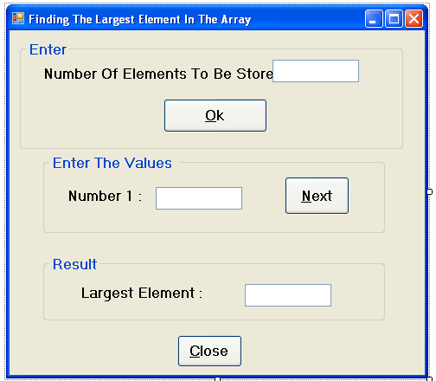

Slide 11
Public Class frmLarge
Dim varNum As Integer
Dim arr() As Integer
Dim varI As Integer
Dim varLarge As Integer
Private Sub BtnOk_Click(ByVal sender As System.Object, ByVal e As System.EventArgs) Handles btnOk.Click
Me.Height = 285
varNum = TextBox1.Text
ReDim arr(varNum)
varI = 0
TextBox2.Focus()
End Sub
Private Sub btnNext_Click(ByVal sender As System.Object, ByVal e As System.EventArgs) Handles btnNext.Click
… …
… …
End Sub
End Class

Slide 12
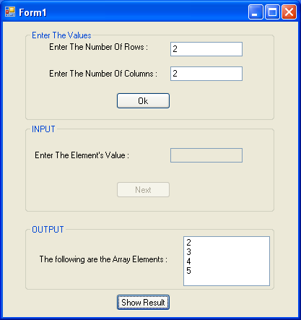
Public Class Form1
Dim arr(,) As Integer
Dim x, y, z As Integer
Dim r, c As Integer
Private Sub Button1_Click(ByVal sender As System.Object, ByVal e As System.EventArgs) Handles Button1.Click
r = TextBox1.Text
c = TextBox2.Text
ReDim arr(r, c)
TextBox3.Focus()
x = 0
y = 0
z = 0
End Sub
Private Sub Button2_Click(ByVal sender As System.Object, ByVal e As System.EventArgs) Handles Button2.Click
arr(x, y) = TextBox3.Text
TextBox3.Focus()
TextBox3.Text = ""
MsgBox(x & " " & y)
If x = r - 1 And y = c - 1 Then
Button2.Enabled = False
TextBox3.Enabled = False
For x = 0 To r - 1
For y = 0 To c - 1
ListBox1.Items.Add(arr(x, y))
Next
Next
End If
If (y < c - 1) Then
y = y + 1
Else
x = x + 1
y = z
End If
End Sub
End Class

Slide 13
Assignments
WAP to store numeric values in an ‘mxn’ matrix and display the sum and average of all the elements in the matrix.
WAP to store numeric values in an ‘mxn’ matrix and display the smallest as well as the largest elements in the matrix.
WAP to store numeric values in an ‘mxm’ matrix and display the sum of each diagonals of the matrix.
WAP to store numeric values in an ‘mxn’ matrix and display the sum of each row and column in the matrix.
WAP to store numeric values in an ‘mxn’ matrix and search for an element and its position in the matrix.

Slide 14
Structure

Slide 15
Structure: User-Defined Data Type
A structure for storing multiple values (of the same or different type) is called a record.
To define a record in VB.NET, use the Structure statement. For example:
Structure stud
Dim varName As String
Dim varRoll As Integer
Dim varClass As Integer
End Structure

Slide 16
Structure: User-Defined Data Type
To declare variables of this new type, we can write:
Dim s1 As stud, s2 As stud
To declare an array of this new type, we can write:
Dim arr( ) As stud
To assign a value to one of these variables, we can write:
s1. varRoll=1
To assign a value to an array of structure, we can write:
arr(0). varRoll=1
Public Class frmStruc
Structure Stud
Dim Name As String
Dim Roll As Integer
End Structure
Dim st() As Stud
… …
… …

Slide 17
Assignment
A form (frmStude) contains a TextBox (txtNumber) to enter number of student records to be stored and two command buttons (cmdOk with the caption Ok and cmdClose with caption Close). As soon as a single-digit number is entered, appropriate number of controls must be available in the form for entering Roll Number, Name, Age and Entrance Marks for the given number of students. There should be another command button which allows to display the details of a student for a particular roll number.

